Slide 1
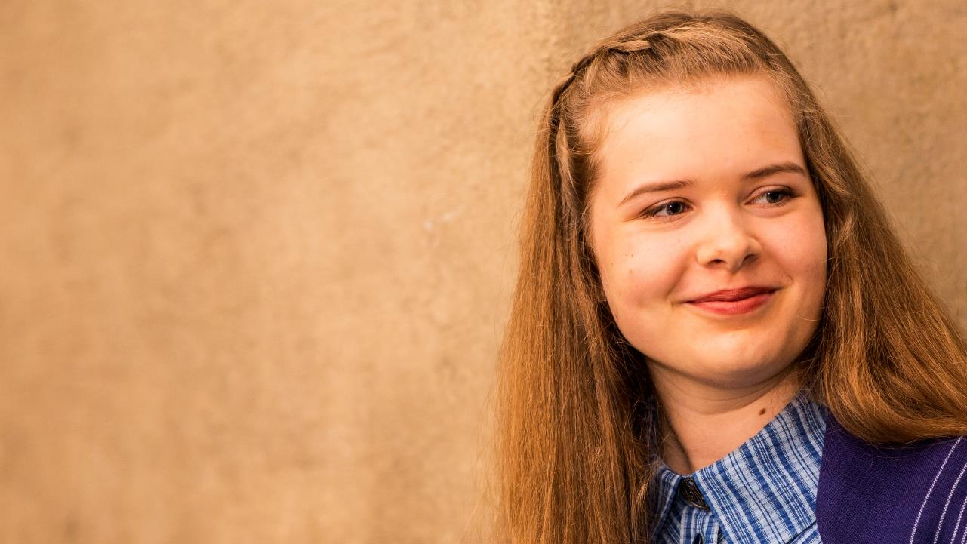
MARTAT
The martHA ORGANIZATION
www.martat.fi/in-english

Slide 2
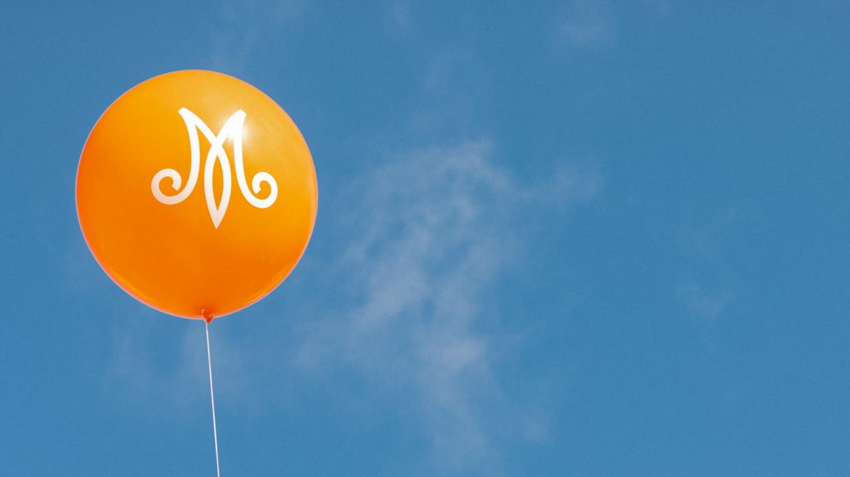
The Martha Organization is a Finnish non-profit association, founded in 1899. It gives advice on home economics and promotes a functioning and sustainable everyday life.
We Marthas believe that a smoothly running everyday life gives you resources and tools to reach for your dreams.
Everyone deserves a good daily life.

Slide 3
HOME ECONOMICS ADVIce
Our advice on food and nutrition, housekeeping, gardening, as well as financial and environmental issues reaches over 100 000 people in Finland every year.
We reach people through our courses, lectures and various events.
Our website www.martat.fi is one of the most popular websites in Finland. It attracts millions of visitors every year.
ⓘ www.martat.fi/marttakoulu

Slide 4
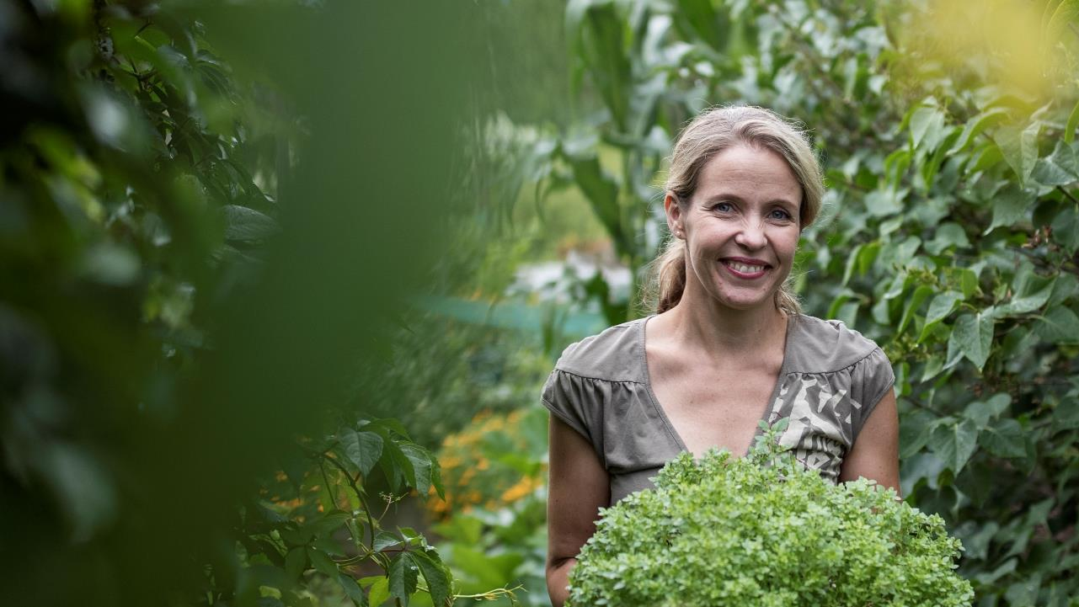
sustainability
Everything we do is based on sustainability and balance with regard to environment, economy and personal health.
Our attitude is From-Words-to-Action. Our positive message encourages people to make responsible choices.
ⓘ www.martat.fi/kestava-arki

Slide 5
BEING MARTHA
In the Martha community you learn new skills and act both locally and globally.
In 2019 more than 44 000 Marthas were active in over one thousand Martha Clubs in more than 250 cities and villages in Finland and abroad.
We Marthas change the world by doing small things in a BIG way.
ⓘ www.martat.fi/tutustu-toimintaamme

Slide 6
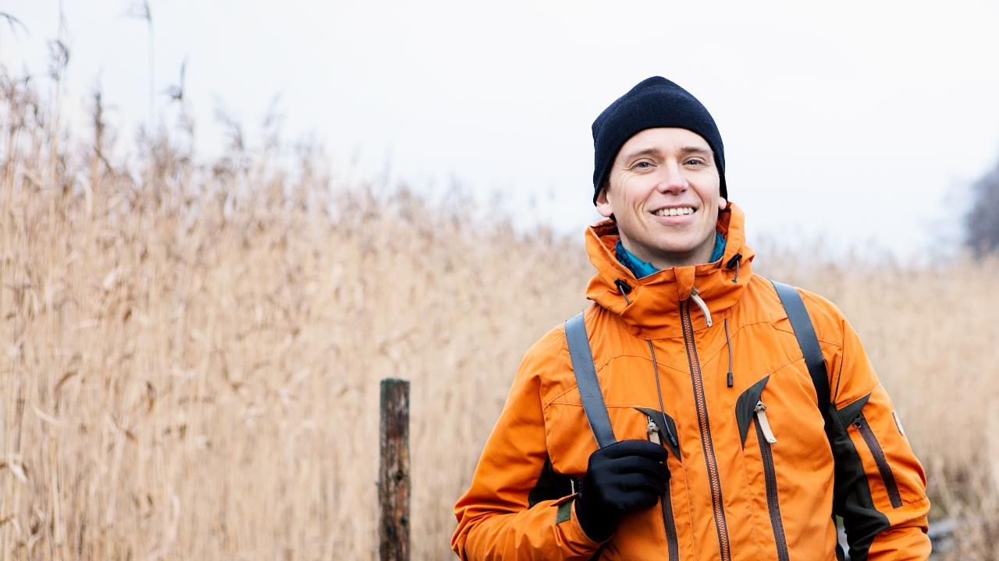
Martha movement belongs to everyone
Everyone regardless of age, sex, national origin, sexual orientation, gender identity, religion or other personal background or choice are welcome to join our clubs and activities.
Our home economics advice is meant for everyone.
ⓘ www.martat.fi/liity-marttoihin

Slide 7
International work
The Martha Organization has carried out development cooperation in Africa for 40 years. Through home economics we aim to improve daily life in our target countries, together with local women’s NGOs, with special focus on women and girls.
We are active members of the Nordic Women’s League and the International Federation for Home Economics (IFHE).
ⓘ www.martat.fi/kansainvalinen-toiminta

Slide 8
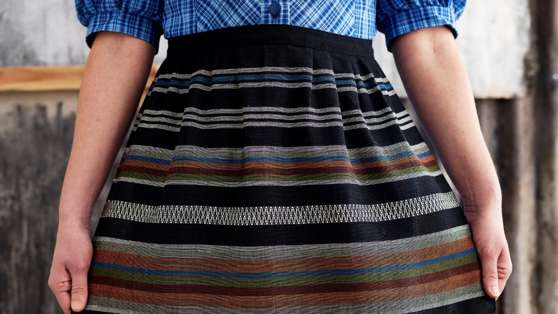
44 000 |  | members
in over 1 000 |  | Martha Clubs
doing over 500 000 |  | hours of volunteering
30 000 |  | Martha events
with over |  | 1 million participants
3 000 events and courses |  | on home economics
with over 90 000 |  | participants
9 million visitors |  | on our website per year
Followers on Social Media
Facebook | Instagram | Twitter | YouTube
@martatvinkkaa | @marttailu | @marttaliitto | MartatTV
90 000 | 30 000 | 9 000 | 2 000

