Slide 1
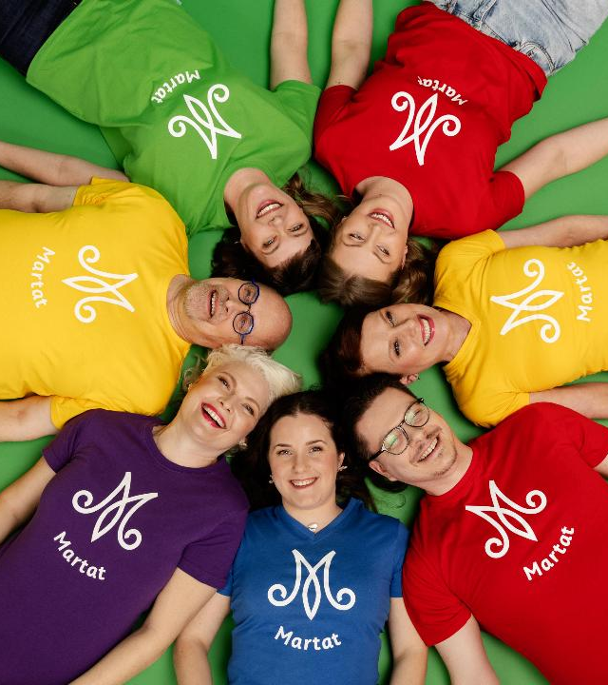
The Martha Organisation
2025

Slide 2
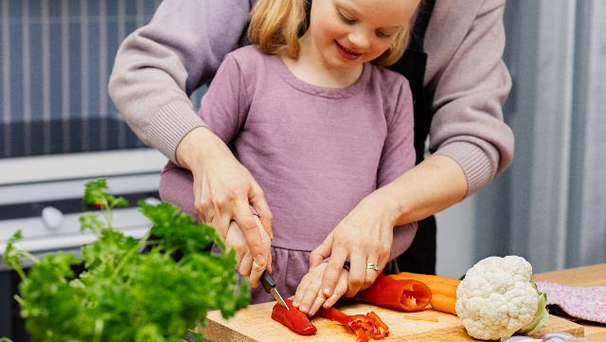
The Martha Organisation
is the best-known
advisory organisation in Finland.
We advocate for
balanced and sustainable everyday life
in all households and families.
Each year, we reach millions of Finns.
Our themes include food, nutrition, household finances, housekeeping, gardening and the environment.
At Marthas, the will to learn a skill turns into action!

Slide 4
The Martha Organisation
WIDE RANGE OF ACTIVITIES
PROFESSIONAL HOME ECONOMICS COUNSELLING
COMMUNICATIONS AND INFLUENCING
Approx. 37,000 members
Approx. 900 clubs
492 500 hours of volunteer work
26,000 member events
800 900 participations
10 regional associations’ home economics and gardening experts together with the central association’s experts
108 000 participations
More than 5,300 group events and public events
More than 10 M. visits to Martat.fi website
More than 260,000 followers on social media
36,00 readers of the Martat magazine

Slide 5
≈ 37,000 members
≈ 900 clubs
10 regional associations

Slide 7
Home economics counselling and community outreach

Slide 8
Towards more sustainable everyday life
We advocate for balanced and sustainable everyday life in all households and families.
We offer advice and counselling in food, nutrition, household finances, housekeeping, gardening and the environment.
Our home economics counselling is open to all, multi-channel and easy access.

Slide 9
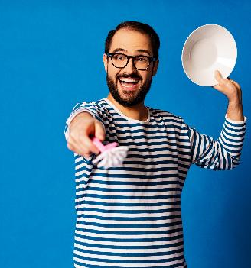
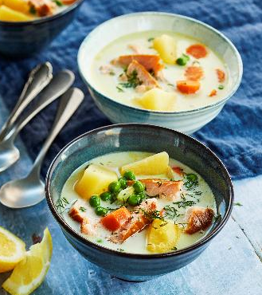
Counselling for everyone
108,000 persons reached in total
5,300 group and public events
482,500 views and listens of Instagram lives
1,762 received calls in the national help line
341 queries answered through the chat service
(Data from 2024)

Slide 10
Satisfied customers
Ratings for Marthas’ home economics counselling:
4.65 overall grade on a scale of 1-5.
92 % found the activity useful.
90 % learned something new.
95 % felt that everyone was treated equally.
95 % would recommend Marthas.
52 % of Finns are familiar with Marthas’ home economics advisory work (the Kestävä arki study).
(Data from 2022 and 2024)

Slide 11
Targeted community outreach
In collaboration with our partners and funders, we support those in need of special support and reduce inequality.
Our outreach work supports independent everyday life and increases inclusion.
Our main target groups include children and families with children, young people, the elderly, men, immigrants, people in mental health or substance abuse rehabilitation as well as people with criminal background and their families.

Slide 12
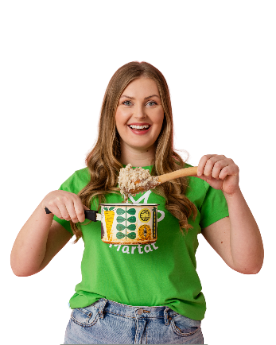
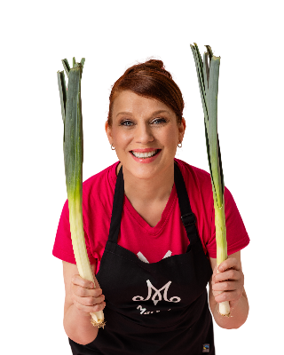
Target groups for targeted community outreach
Families with children
The elderly
Vilppu
Asylum seekers, refugees,
other immigrants
People in mental health or substance abuse rehabilitation, people with criminal background and their families
The financially vulnerable
Lapsiperheiden arjen tukeminen, Makumatka Karjalaan, Ässäkokit, Vilppu, Junnukokit
Young people
Arki sujuvaksi
Arki sujuvaksi
Kestävät talouspolut
Arki sujuvaksi, Valioakatemia

Slide 13
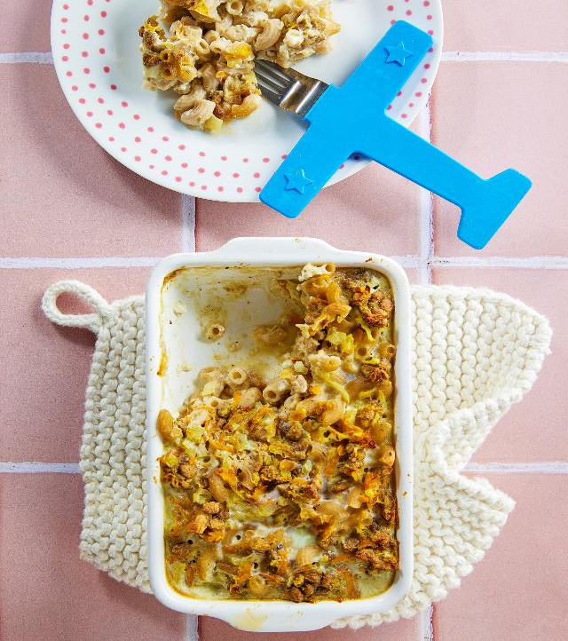
Arki sujuvaksi
Within our Arki sujuvaksi program, we offer home economics classes across the country for youth not in employment, education or training, people in mental health and substance abuse rehabilitation, immigrants and their families as well as prisoners and those serving a community sanction.
The goal is to make everyday life easier and to improve the participants’ basic life skills as well as social skills with the help of practical home economics classes.
ⓘ www.martat.fi/arki-sujuvaksi (in Finnish)

Slide 14
Lapsiperheiden arjen tukeminen
We support the daily life of families with children under the age of 18 months by organising home economics classes and lectures for parents and providing personal support through home visits.
ⓘ www.martat.fi/lapsiperheiden-arjen-tukeminen (in Finnish)

Slide 15
Makumatka Karjalaan
In the Makumatka Karjalaan (”Taste trip to Karelia”) classes, the participants learn to make different types of Karelian pasties and other pastries. The courses are aimed primarily at children and young people and are funded by the Karjalan Kulttuurirahasto (Karelian cultural fund).
ⓘ www.martat.fi/makumatka-karjalaan (in Finnish)

Slide 16
Ässäkokit
The Ässäkokki cookery classes for children of 8 to 12 years of age are organised across the country in collaboration with the S Group.
The goal is to encourage children to cook, to increase their vegetable consumption and to improve their practical skills.
Working together, everyday food skills, smart spending and seasonal thinking are at the core of the program.
ⓘ www.martat.fi/assakokit (in Finnish)

Slide 17
Kestävät talouspolut
Joint development project by the Guarantee Foundation and Martha Association (2022-2024).
The goal is to strengthen the financial capacity, sustainable daily life and management of personal finances as well as support the inclusion and the opportunities to influence of the financially vulnerable.
ⓘ www.martat.fi/kestavat-talouspolut (in Finnish)

Slide 18
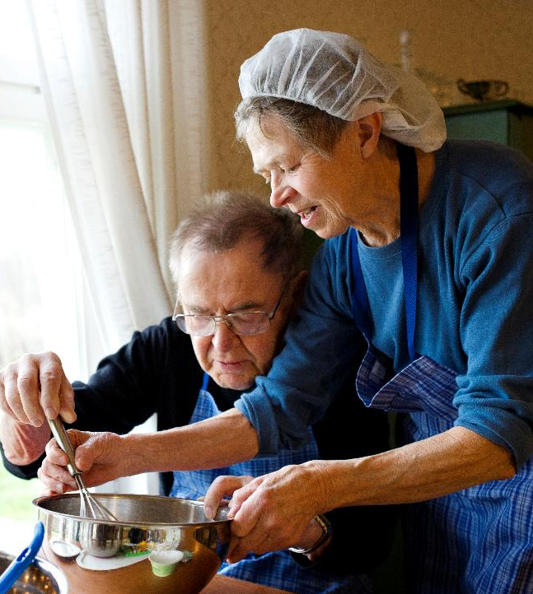
Vilppu
In the Vilppu program, volunteers work to support the everyday life and increase the wellbeing of the elderly and families with children.
The goal is to support the ability of the elderly to continue to live in their own home and the everyday life of families with children. The program also aims to reduce loneliness.
ⓘ www.martat.fi/vilppu (in Finnish)

Slide 19
Membership

Slide 20
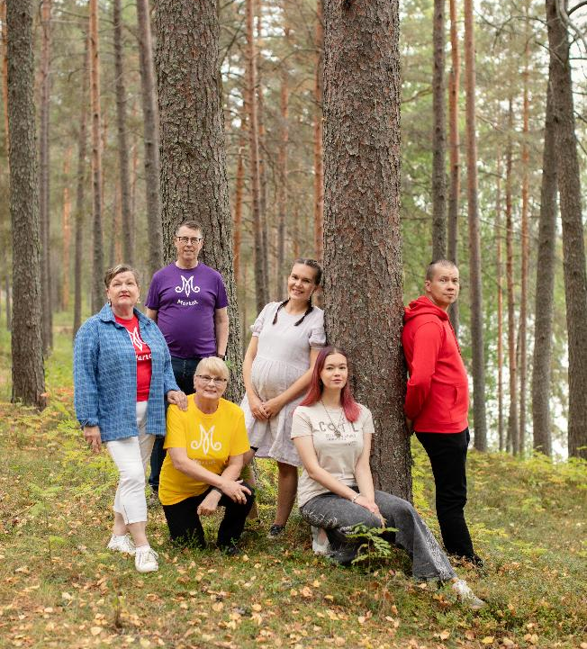
Everyone is welcome
Regardless of age, gender, nationality, sexual orientation, religion, conviction or other background, everyone is welcome to join the Marthas.

Slide 21
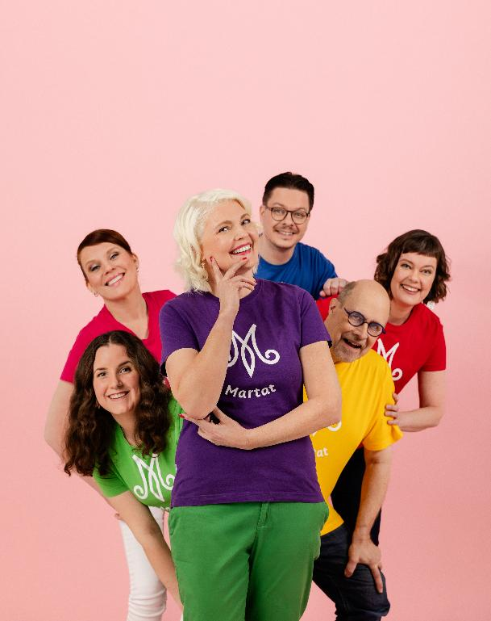
Marthas is a strong community
By becoming a member, you learn new skills and can make an impact on your community and the society as a whole.
37,000 members in over 900 clubs all over Finland.
Martha members change the world by doing small deeds in a big way.

Slide 22
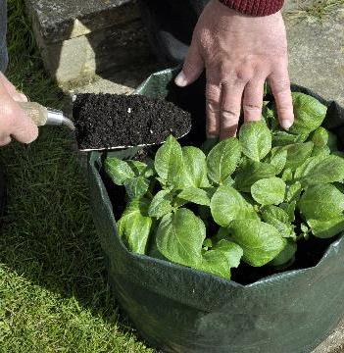
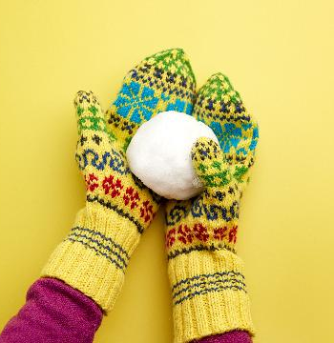
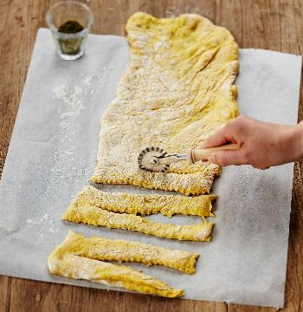
Some of the main fields of interest in Martha clubs
Arts and crafts
Food and nutrition
Wellbeing
Culture
Foraging
Gardening and house plants
Physical exercise

Slide 23
Resilience

Slide 24
The vital functions of society and the role of Marthas
Managing one’s everyday life at home is the starting point for a functioning society
We increase inclusion and reduce inequality
We promote a sense of community and provide purpose
The role of voluntary activities and active citizenship
We promote self-preparedness and offer advice especially on household stockpile and home gardening
We promote the Sustainable Development Goals (SDGs)

Slide 25
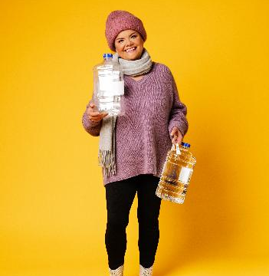
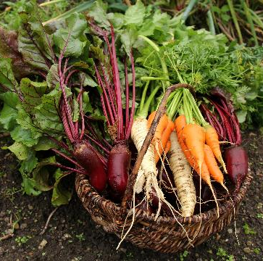
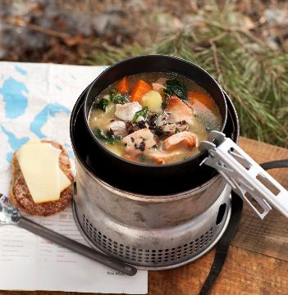
Psychological Resilience
The Marthas increase resilience by promoting wellbeing in homes and families.
To us, resilience is society’s and nature’s capacity to adapt to changing circumstances.
People need to feel, that they are able and resilient and know what to do in a crisis or abnormal situation.
The role of skills and knowledge
the importance of communication, campaigning and advisory work
The ability to stay hopeful and optimistic for the future.

Slide 26
Communications and advocacy

Slide 27
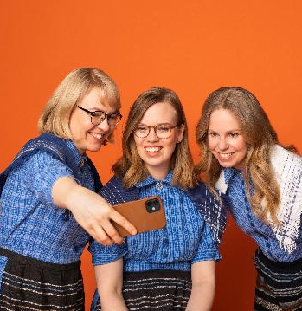
We communicate and advocate
We advocate for environmentally, economically and socially sustainable choices.
Our other themes include preparedness, sustainable energy consumption, sustainability change in food as well as the phenomena related to greenwashing.
We work in several committees, issue statements and participate in social discourse and campaings.

Slide 28
International work

Slide 29
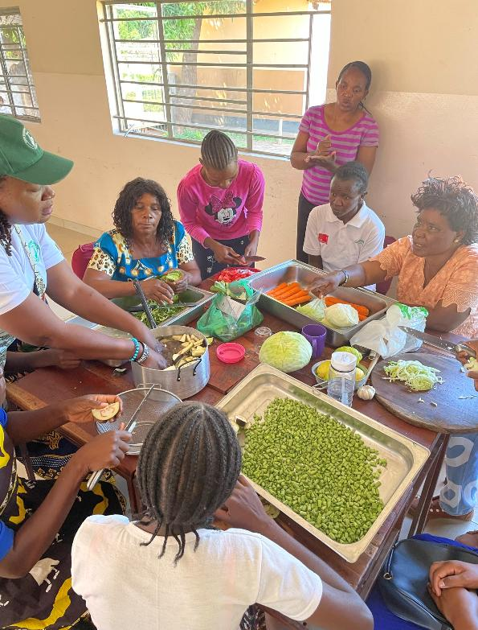
More than 40 years of cooperation in Africa
Our international projects support women in vulnerable positions.
In Ethiopia, we collaborate with Finnish and Ethiopian disability organizations.
In Malawi, we support groups of mothers in rural areas by providing trainings and microfinancing in collaboration with Finnish and Malawian organizations working for sexual health and rights.
In Zambia, we support women with disabilities in achieving stable everyday life and livelihood
In Somaliland, we increase the nutritional skills and financial status of women in vulnerable position.

Slide 30
Collaborations
and partnerships

Slide 31
Examples of commercial partners
Fazer – joint course material related to oat (Kaikkea kaurasta)
Fiskars – pan school in social media and martat.fi
Nordqvist – tea party themed campaign to recruit new members (Martan teehetki)
S Group – cookery classes for children since 2018 (Ässäkokki)
Biolan – series of videos about composting
Tulikivi – series of videos about cooking with a fireplace in collaboration with the North Karelia (Pohjois-Karjala) Martha district (Viikon takkaruokareseptit)

Slide 32
Summary

Slide 33
Members |  |  | 37,000
Clubs |  |  | Approx. 900
Hours of volunteer work |  |  | 492,500
Member events |  |  | 26,000
Event participants |  |  | 800,900
Advisory events |  |  | 5,300
Event participants |  |  | 108,000
Martat.fi website visits |  |  | 10 million
Facebook | Instagram | X | LinkedIn | YouTube | TikTok | Magazine
@martatvinkkaa | @marttailu | @martta-liitto | Martat | MartatTV | Marttailu | Martat
104,000 | 130,000 | 10,000 | 2,600 | 4,500 | 5,000 | 36,000

Slide 34
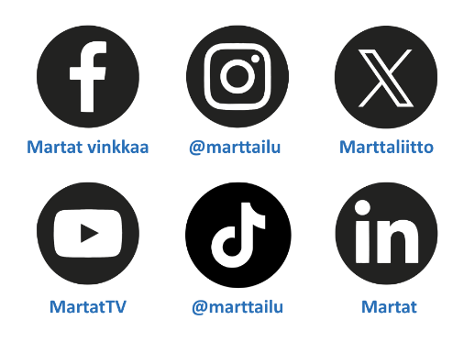
Follow Marthas on social media!

