Slide 1
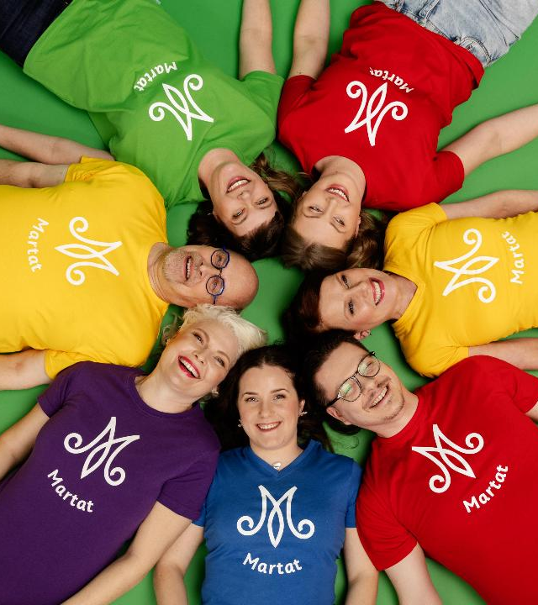

The Martat Organisation

Slide 2
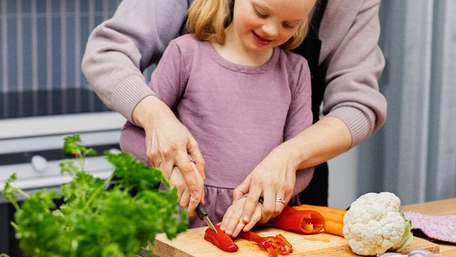


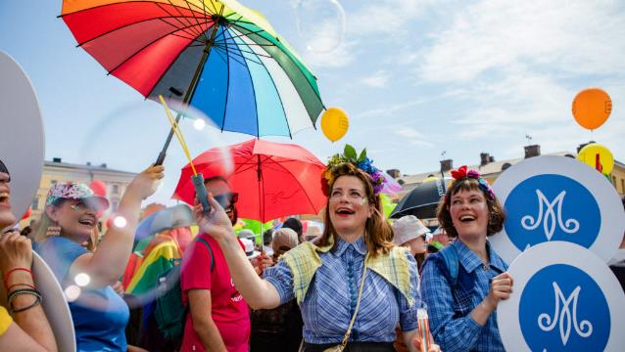
The Martat Organisation
is the best-known
advisory organisation in Finland.
We advocate for
balanced and sustainable everyday life
in all households and families.
Each year, we reach millions of Finns.
Our themes include
Food and nutrition
Household finances and housekeeping
Resilience and preparedness
Gardening and the environment
Natural products
”At the Martat, the will to learn a skill
turns into action!”

Slide 3
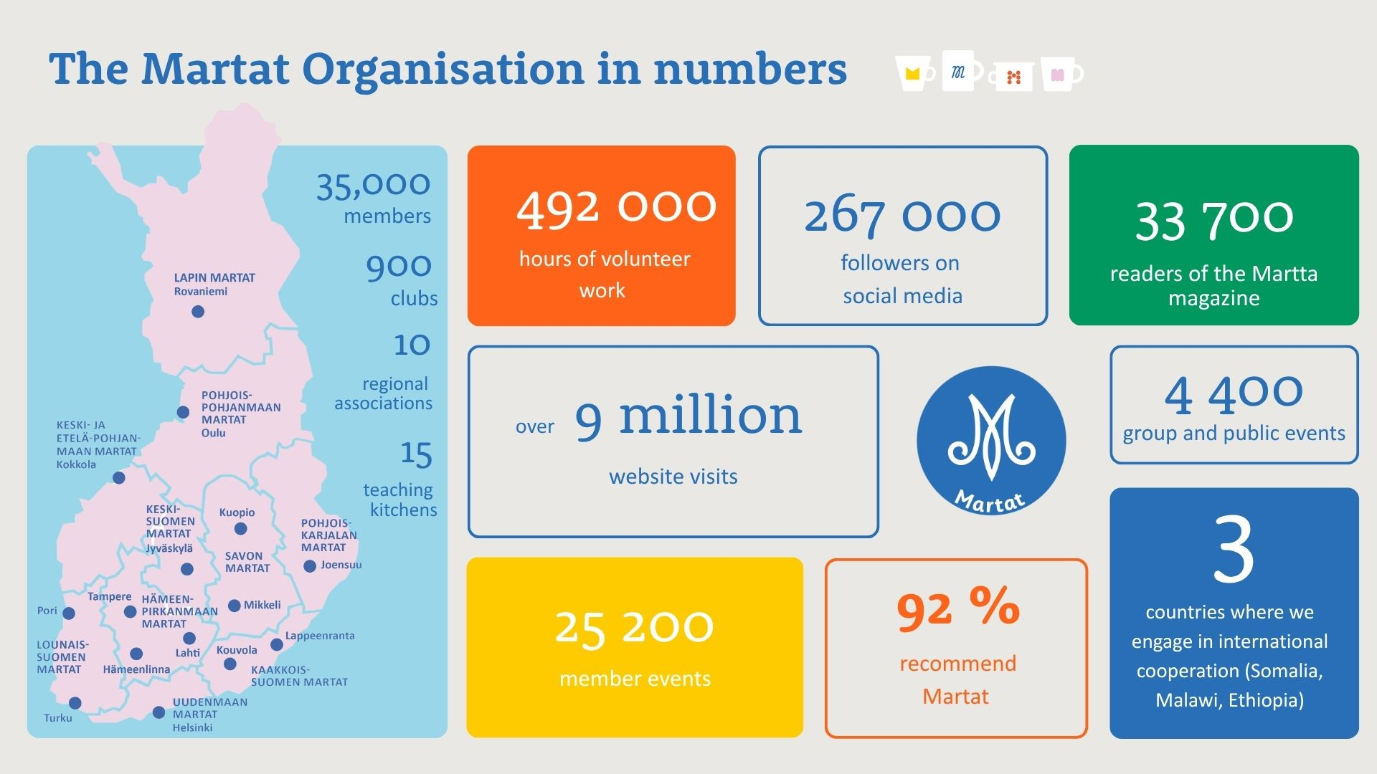

Slide 4


Slide 5
Home economics counselling and community outreach

Slide 6
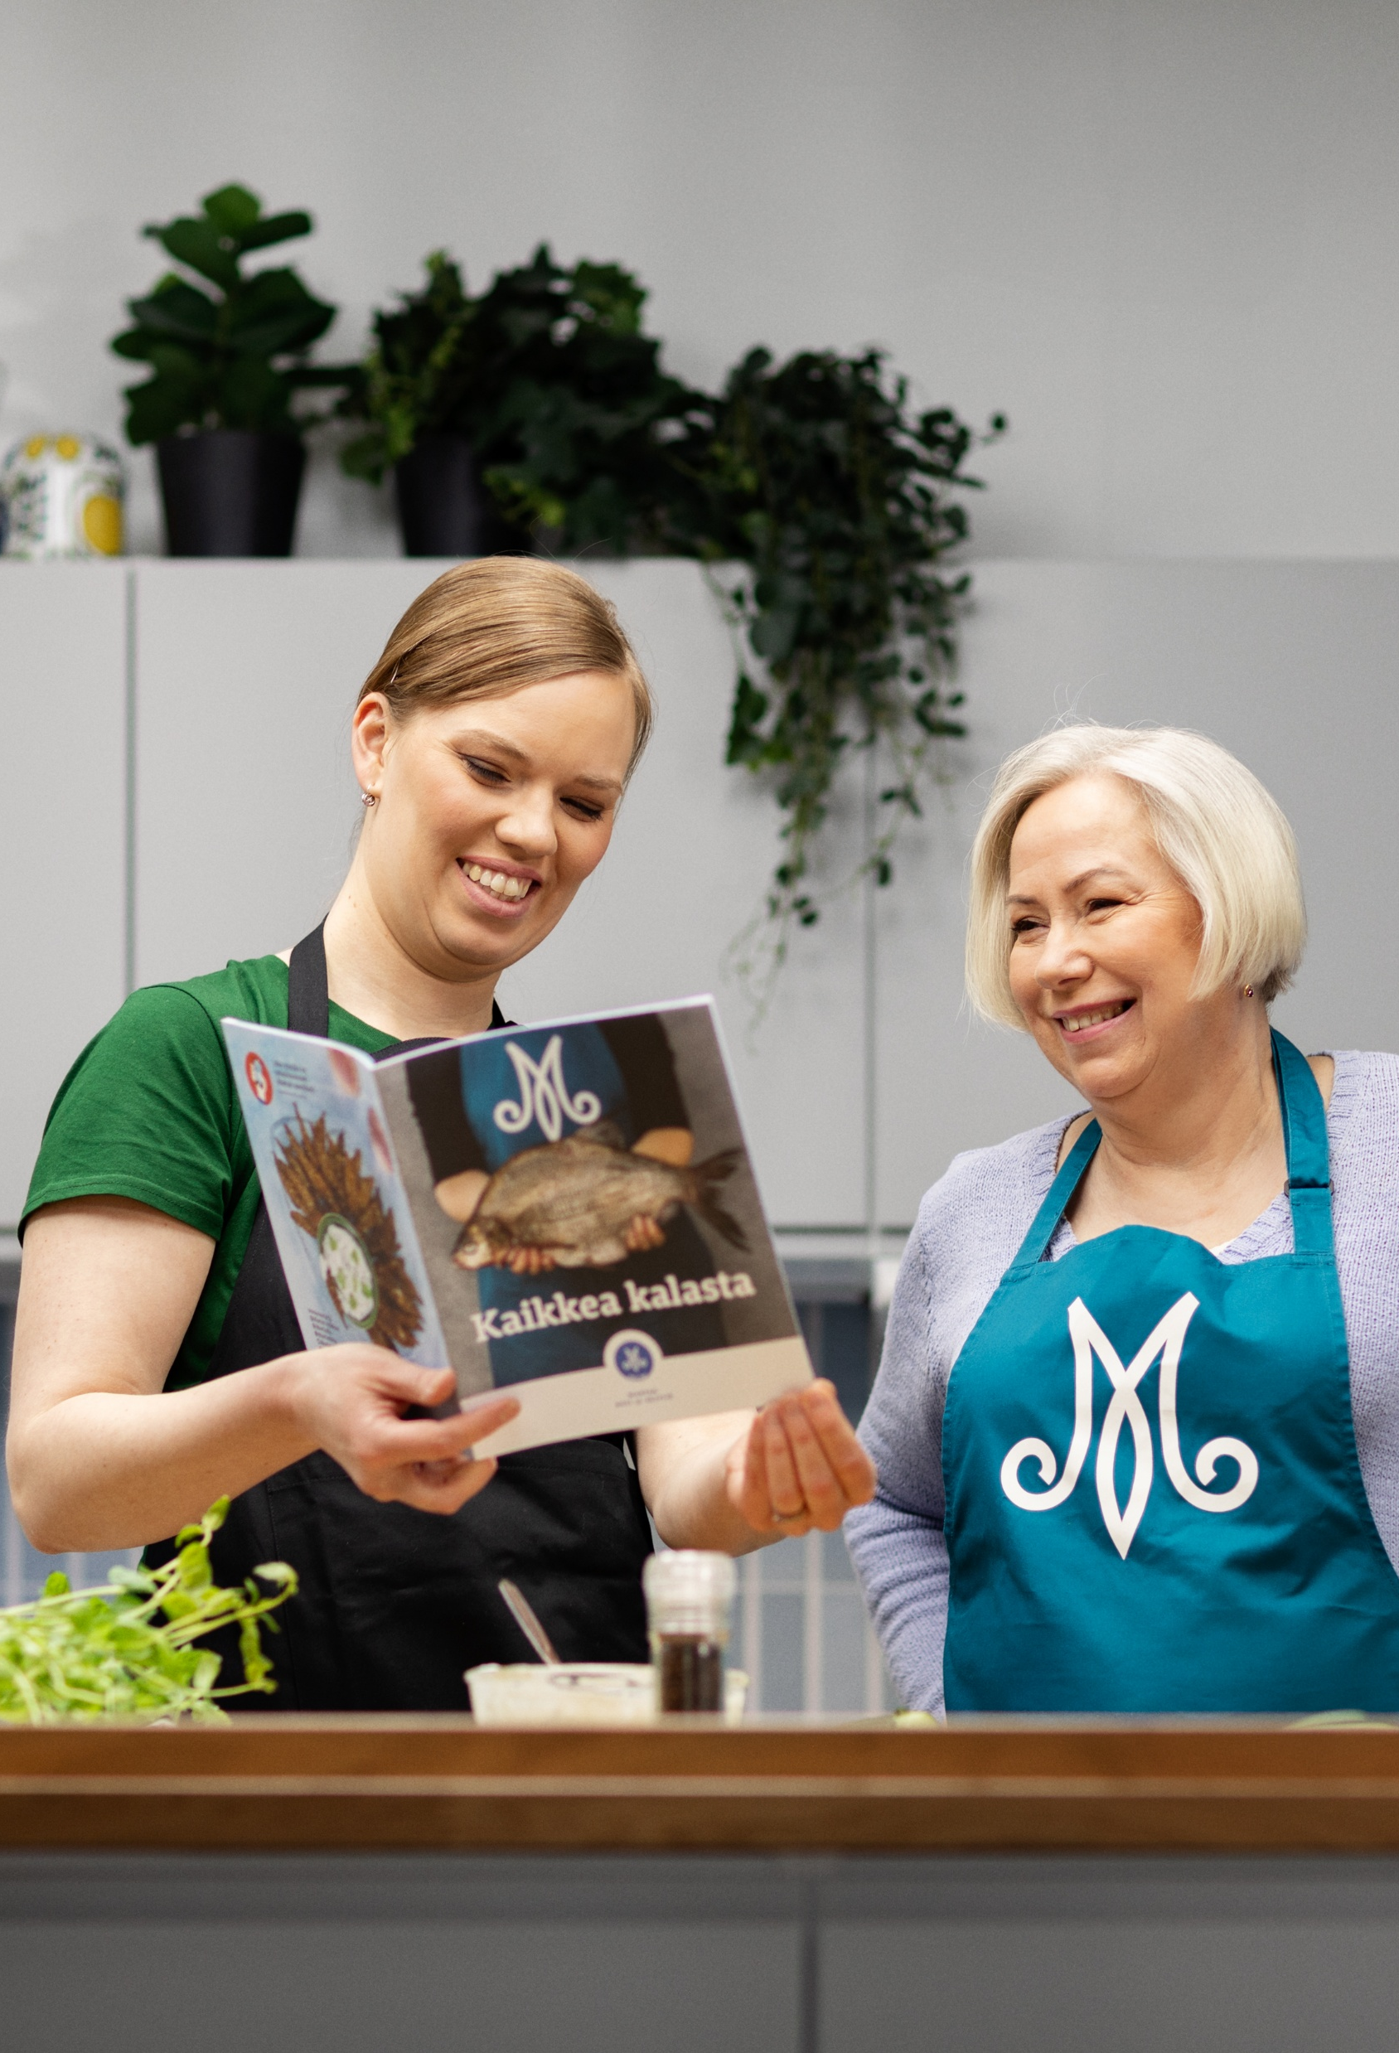
Towards a more sustainable everyday life
We advocate for a balanced and sustainable everyday life in all households and families.
We offer advice and counselling relating to food, nutrition, natural products, household finances, housekeeping, gardening and the environment.
Our home economics counselling is open to all, multi-channel and easy access.

Slide 7
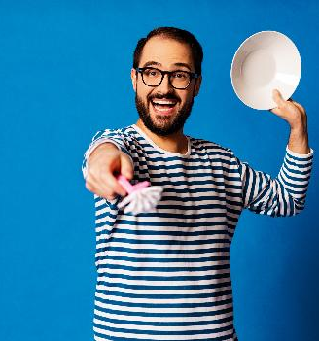


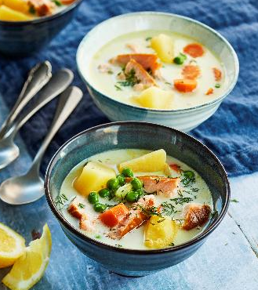
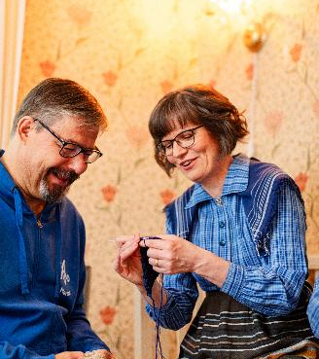
Counselling for everyone
92 300 event participants
4 400 group and public events
292 000 Instagram live views
1 462 Martat help line calls received
352 queries answered through the chat service
(Data from 2025)

Slide 8
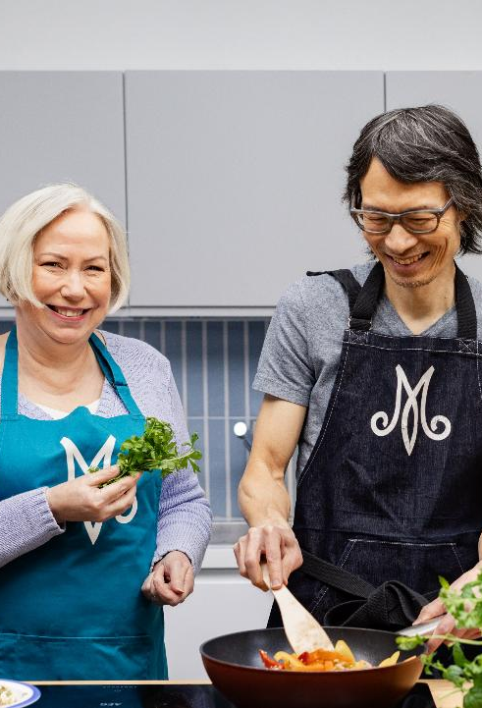
Satisfied customers
Ratings for Martat’s home economics counselling:
4.6 overall grade on a scale of 1–5.
90 % found the activity useful.
84 % learned something new.
62 % became more interested in making sustainable choices.
92 % would recommend Martat.
52 % of Finns are familiar with Martat’s home economics advisory work (the Kestävä arki study*).
(*Data from 2024 and 2025)

Slide 9
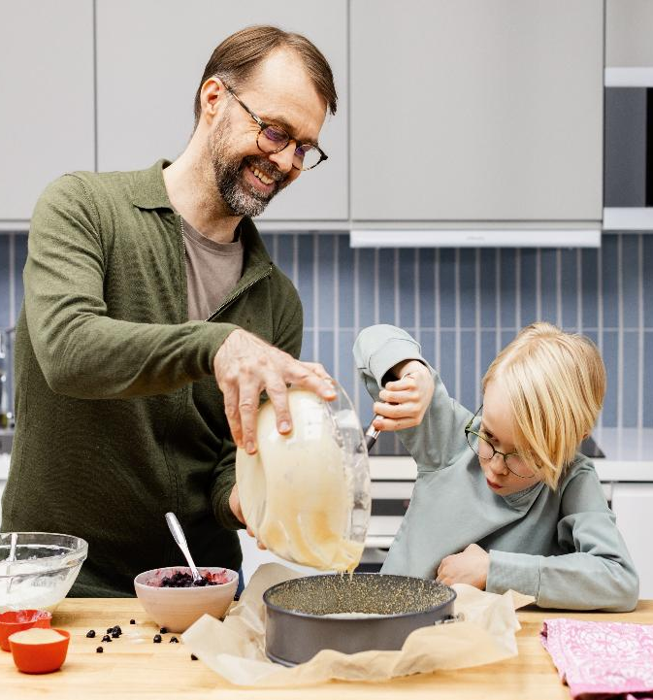
Targeted community outreach
In collaboration with our partners and funders, we support those in need of special support and reduce inequality.
Our outreach work supports people in living independently. It also increases participants' inclusion in society.
Our target groups include children and families with children, young people, the elderly, people in mental health or substance abuse rehabilitation as well as people with a criminal background.

Slide 10
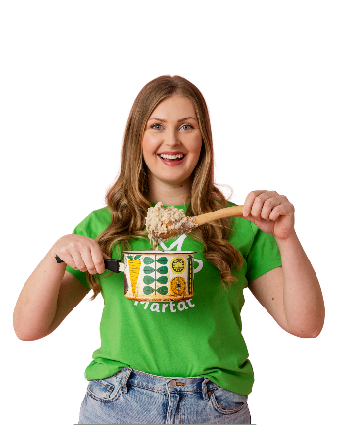
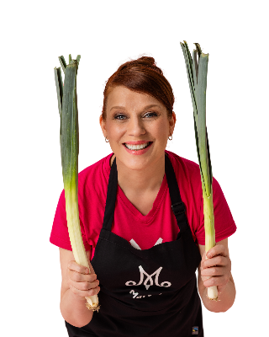
Target groups for targeted community outreach
Families with children
The elderly
Vilppu
People in mental health or substance abuse rehabilitation, people with criminal background
Lapsiperheiden arjen tukeminen, Makumatka Karjalaan,
Ässäkokit, Vilppu, Junnukokit
Young people
Arki sujuvaksi
Fiksuja valintoja, Makumatka Karjalaan

Slide 11
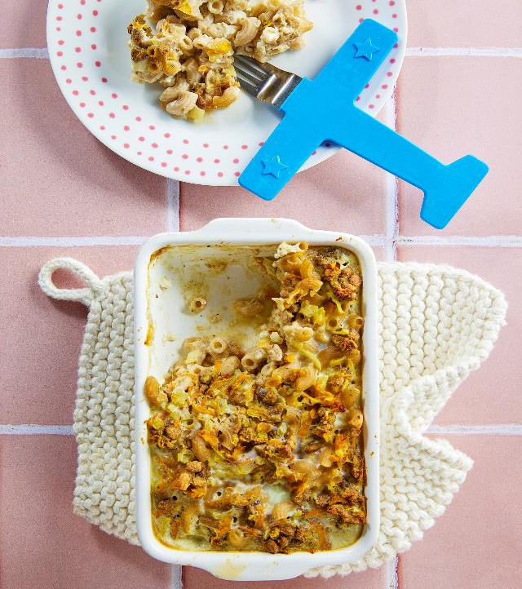

Arki sujuvaksi
Within our Arki sujuvaksi program, we offer home economics classes across the country for people in mental health and substance abuse rehabilitation as well as prisoners and those serving a community sanction.
The goal is to make everyday life easier and to improve the participants’ basic life skills as well as social skills with the help of practical home economics classes.
ⓘ www.martat.fi/arki-sujuvaksi (in Finnish)

Slide 12
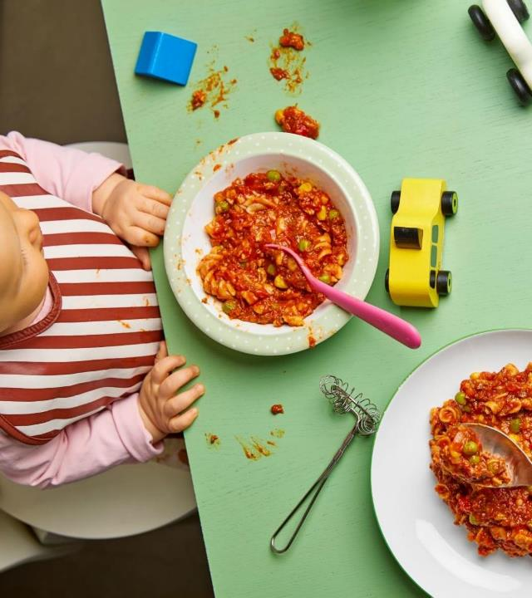
Lapsiperheiden arjen tukeminen
We support the daily life of families with children under the age of 18 months by organising home economics classes and lectures for parents and providing personal support through home visits.
ⓘ www.martat.fi/lapsiperheiden-arjen-tukeminen (in Finnish)

Slide 13
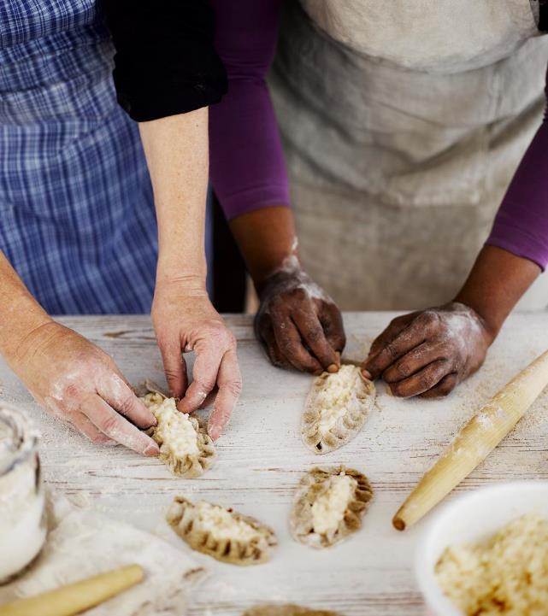

Makumatka Karjalaan
In the Makumatka Karjalaan (”Taste trip to Karelia”) classes, the participants learn to make different types of Karelian pasties and other pastries. The courses are aimed primarily at children and young people and are funded by Karjalan Kulttuurirahasto (Karelian cultural fund).
ⓘ www.martat.fi/makumatka-karjalaan (in Finnish)

Slide 14

Ässäkokit
The Ässäkokit cooking classes for 8-12 year-old children are organised across the country in collaboration with the S Group.
The goal is to encourage children to cook, to increase their vegetable consumption as well as to improve their practical skills in the kitchen and beyond.
Working together, learning everyday food skills, smart spending and seasonal thinking are at the core of the program.
ⓘ www.martat.fi/assakokit (in Finnish)

Slide 15
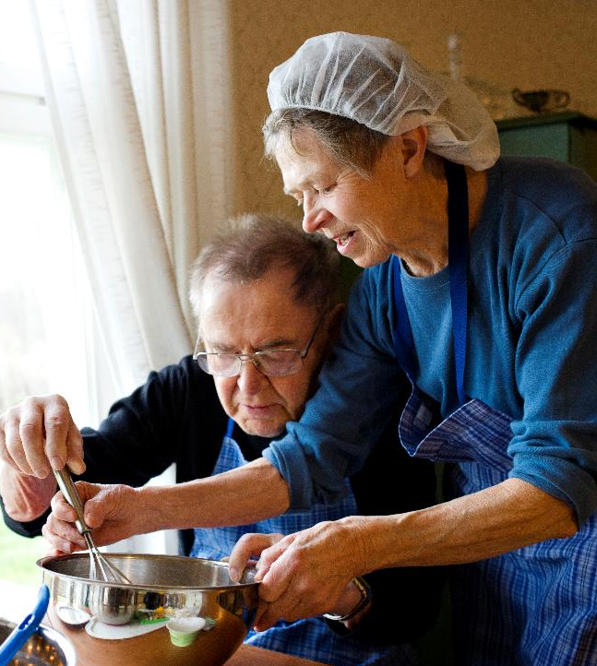
Vilppu
In the Vilppu program, volunteers work to support the everyday life and increase the wellbeing of the elderly.
The goal is to support the ability of the elderly to continue living in their own home. The program also aims to reduce loneliness.
ⓘ www.martat.fi/vilppu (in Finnish)

Slide 16
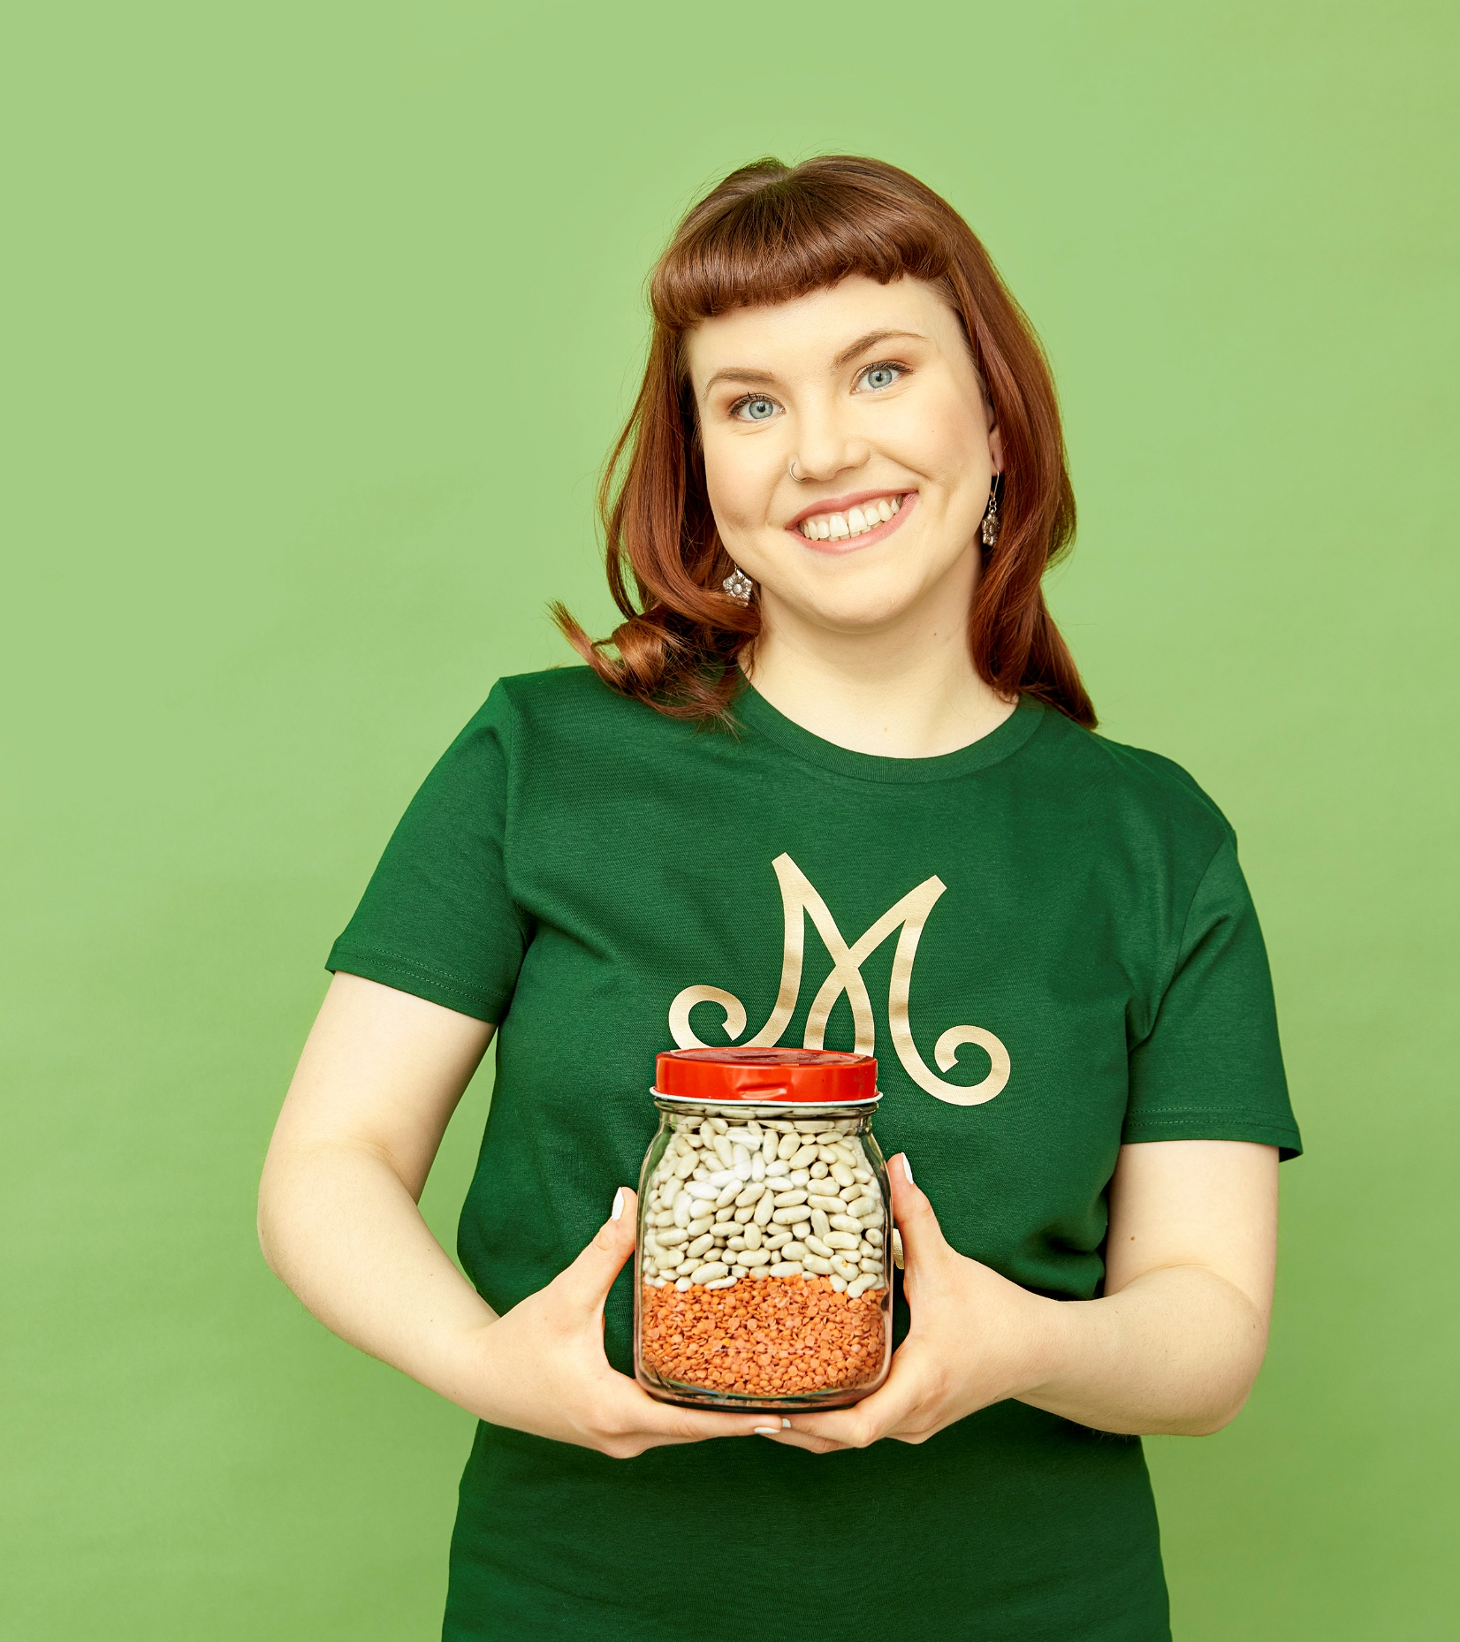
Fiksuja valintoja
Fiksuja valintoja is a three-year project coordinated by the Martat Association.
Its goal is to strengthen the cooking skills and everyday life management of young adults moving out of the family home.
The project is carried out in collaboration between the Martat organisation and local Martat clubs and volunteers.
The project is funded by the Ministry of Agriculture and Forestry.
ⓘ www.martat.fi/fiksuja-valintoja (in Finnish)

Slide 17
Membership

Slide 18
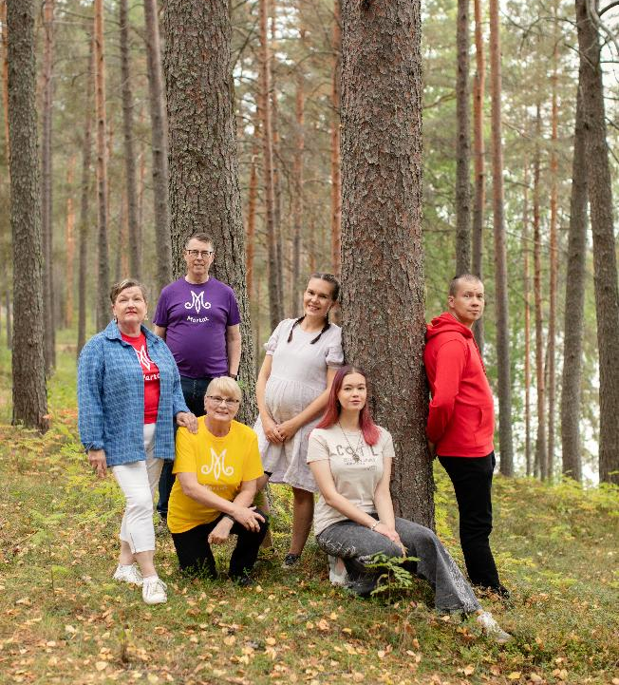
Everyone is welcome
Regardless of age, gender, nationality, sexual orientation, religion, conviction or other background, everyone is welcome to join the Martat.

Slide 19

The Martat is a strong community
By becoming a member, you learn new skills and can have an impact on your community and society as a whole.
The member community consists of 35,000 members in over 900 clubs all over Finland.
Martat members change the world by doing small deeds in a big way.

Slide 20
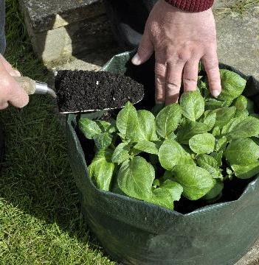



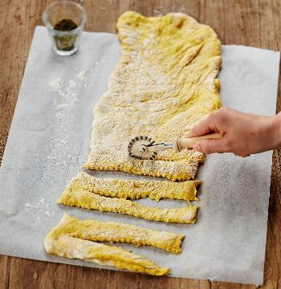
Some of the main fields of interest in Martat clubs
Arts and crafts
Food and nutrition
Wellbeing
Culture
Foraging
Gardening and house plants
Physical exercise

Slide 21
Resilience

Slide 22
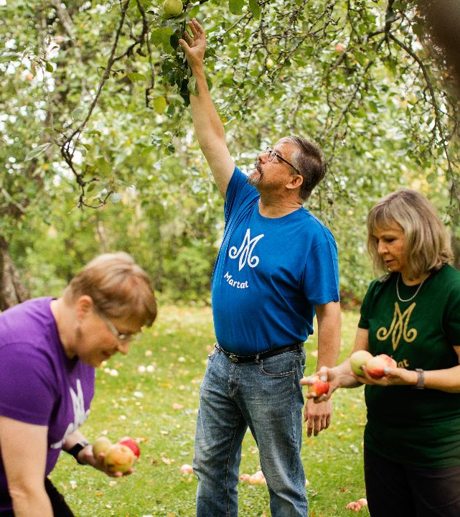
The vital functions of society and the role of Martat
Managing one’s everyday life at home is the starting point for a functioning society.
We increase inclusion and reduce inequality.
We promote a sense of community and provide purpose.
We provide opportunities for volunteer work and encourage active citizenship.
We promote self-preparedness and offer advice especially on how to garden and prepare a household stockpile.
We promote the Sustainable Development Goals (SDGs).

Slide 23
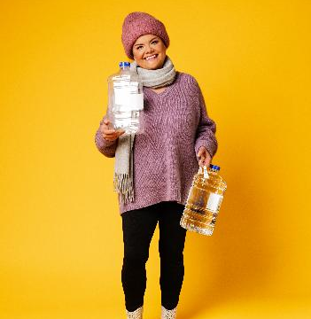

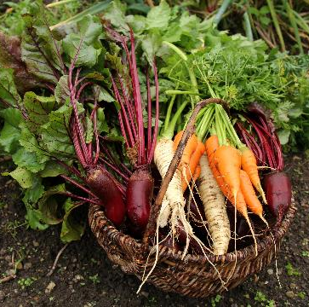
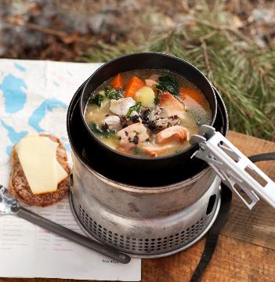
Mental resilience
The Martat improve resilience by promoting wellbeing in homes and families.
For us, resilience is society’s and nature’s capacity to adapt to changing circumstances.
People should feel that they have the abilities, resilience and knowledge needed to cope in a crisis or unusual situation.
We emphasise
  the role of skills and knowledge
  the importance of communication, campaigning and advisory work
  the ability to stay hopeful and optimistic for the future.

Slide 24
Communications and advocacy

Slide 25
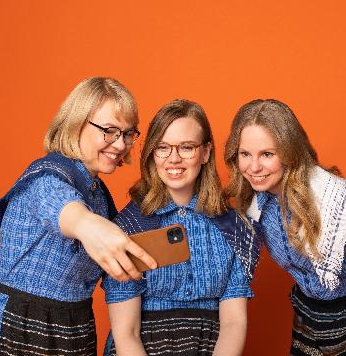
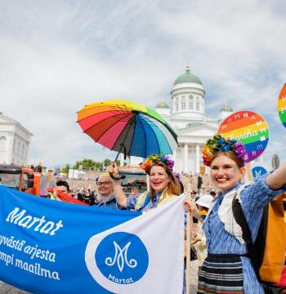

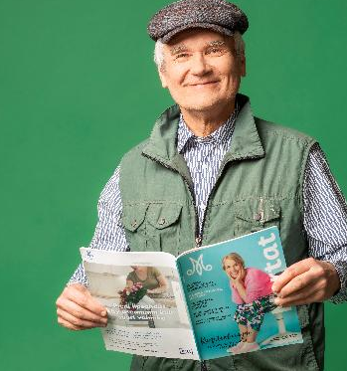

We educate and advocate
We advocate for environmentally, economically and socially sustainable choices.
Our other themes include preparedness, sustainable energy consumption, the sustainability transition in food as well as the phenomena related to greenwashing.
We work in several committees, issue statements and participate in social discourse and campaings.

Slide 26
International cooperation

Slide 27
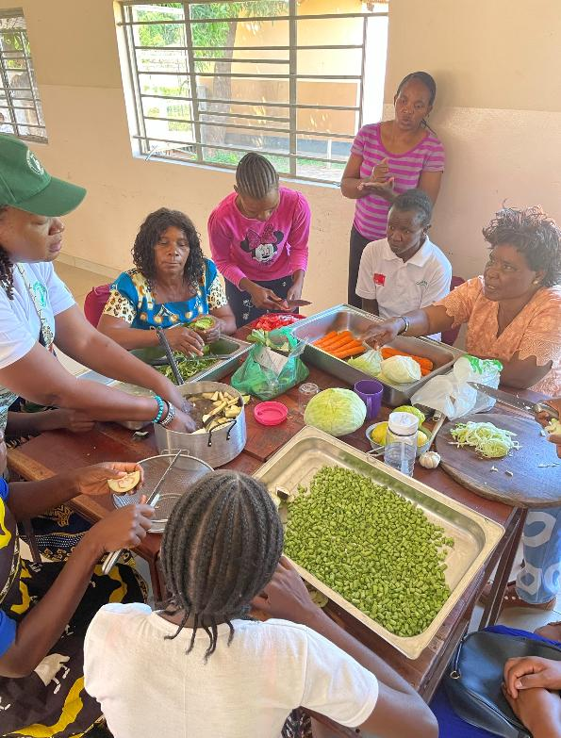
Internartional cooperation promotes good nutrition and women's rights
Our international projects support women in vulnerable positions.
In Ethiopia, we collaborate with Finnish and Ethiopian disability organisations.
In Malawi, we support groups of mothers in rural areas by providing trainings and microfinancing in collaboration with Finnish and Malawian organisations working for sexual health and rights.
In Somaliland, we work towards increasing the nutritional skills and financial status of women in vulnerable positions.

Slide 28
Collaborations
and partnerships

Slide 29

Examples of commercial collaborations
Laihian Mallas – Content collaboration
Saimaan Tuore – Content collaboration
Gummerus – Book collaboration
Electrolux – Content collaboration
Fiskars – Frying pan tutorial on social media and martat.fi
Nordqvist – Tea party -themed membership campaign (Martan teehetki)
S Group – Cookery classes for children since 2018 (Ässäkokki)

Slide 30
Summary

Slide 31
Members |  |  | 35,000
Clubs |  |  | 882
Volunteer work |  |  | 492 person-years
Member events |  |  | 25,200
Event participants |  |  | 900,000
Group and public events |  |  | 4,400
Advisory event participants |  |  | 92,300
Martat.fi website visits |  |  | 9 million
Facebook | Instagram | Threads | LinkedIn | YouTube | TikTok | Magazine
Martat vinkkaa | Marttailu | Marttailu | Martat | MartatTV | Marttailu | Martta
112,000 | 138,000 | 15,000 | 3,200 | 4,500 | 5,500 | 40,000

Slide 32
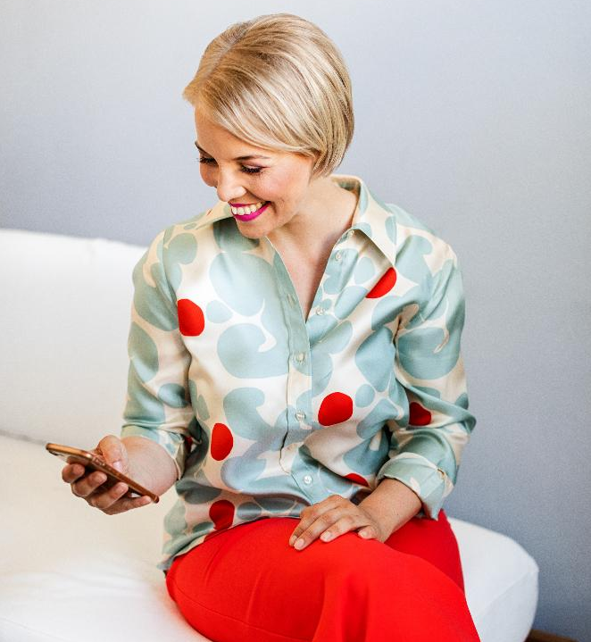


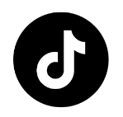



Follow the Martat on social media!
Martat
vinkkaa
Marttailu
Marttailu
Marttailu
MartatTv
Martat

